Slide 1


VCS Engagement
Day 2024
Welcome!

Slide 2
Synopsis of the last 18 months

Slide 3
National updates – since we last met
National political landscape has changed:
General election in July 2024
2 Prime Ministers
3 Home Secretaries
5 Ministers for Immigration with varying remits
Worsening situation in the Middle East
Far right riots and rise in anti-immigration sentiment
Two Yorkshire Integration Festivals in Sheffield and Halifax
Notes:
Change in politics always leads to systems slowing down while new Ministers get to grips with portfolios

Slide 4
National updates – what's on the horizon?
Ongoing conflicts in the Middle East, Ukraine, Sudan and elsewhere - 6 global conflicts and crises to watch in 2024
Ongoing work to bring down net migration - Labour’s pledges on migration: the data - Migration Observatory - The Migration Observatory
Illegal Migration Act is still the most up to date legislation
Impact of the appointment of new Border Security Commander
Lack of legal provision
Asylum and NRM backlogs
Roll out of e-visas

Slide 5
Asylum updates – since we last met
Safety of Rwanda Bill has come and gone
Bibby Stockholm and other large sites not progressing
Pressures of the Streamlined asylum process last winter
Decision making has started again

Slide 6
Asylum – what's on the horizon?
Increase in decision making and homelessness, but no evictions between 20 Dec 2024 – 2 Jan 2025
Roll out of e-visas and farewell to BRPs
Ongoing progress against the full dispersal plan, and continued use of hotels

Slide 7

UASC updates – since we last met
UASC Definition:
Anyone aged under 18 who claims asylum in their own right, and is not accompanied by a parent or other adult with responsibility for them.
Social Care Duties
Local authorities - duty to care for UASC as Children Looked After (s20 of the Children Act 1989).
Former UASC 18+, in receipt of 13 weeks+ of support under s20 = entitled to support as Care Leavers (Children Leaving Care Act 2000).
National Transfer Scheme - mandated since 2021
Stats
July 23 – Jun 24 = 4,781 UASC applied for asylum.
94% male, majority aged 16/17.
UASC = 9% of all CLA in England in 23/24, up from 6% in 2020.
Former-UASC care leavers numbers increasing, need for support.
Notes:
STATS
July 2023 – June 2024 = 4,781 asylum applications from UASC. ​
Top 6 nationalities Sudan (24%),​ Afghanistan (18%), Iran (15%), Eritrea (9%), Vietnam (8%) & Syria (6%)​
94% of UASC applicants were male. ​​
In the same period, 6,231 initial decisions were made for UASC applications. 66% were granted some form of leave, while 22% were refused or withdrawn.​​
Apr 23 – Mar 24 – UASC = 9% of all CLA in England (up from 6% in 2020). Former uasc care leavers = 34% of all 18yr old care leavers, 27% of all 19-21 yr old care leavers. Children looked after in England including adoptions, Reporting year 2024 - Explore education statistics - GOV.UK

Slide 8
UASC – what's on the horizon?
Age Disputes/Assessments
Children wrongly assessed as adults at Port.
Children classed as UASC, but age disputed pending assessment.
Age Assessment process – NAAB, potential scientific methods.
Placement issues
Lack of placements, rising costs vs. no LA funding increase
Post 18 move on accommodation
Lack of legal aid -Delays asylum and appeals process, children in 'limbo', 'ageing out'
Mental health & wellbeing impact- high demand for services, long waiting lists
News
SAP/PIM re-instated November 2024 - for top 5 grant rate countries
(Afghanistan, Eritrea, South Sudan, Sudan & Syria).
Notes:
Age Assessments
HO incorrect age determinations at port leading to increase in referrals to LA/VCS through adult asylum route – impact on young people (e.g.Ref Council report Forced Adulthood: The Home Office’s incorrect determination of age and how this leaves child refugees at risk. - Refugee Council)
NAAB – launched 31/03/23. Social Workers recruited by Home Office with sole responsibility of doing age assessments/supporting LA's to conduct AA's. Offering AA training to LA's.
NABA – introduction of 'scientific methods of age assessment' – used in Europe. Dental/X-Ray/MRI – no accurate way to determine age (e.g. dental – can be 3-5 years out either side). Scientific methods to be used alongside existing social worker assessment. Moral questions around consent, safeguarding.
SAP/PIM - re-instated November 2024 - for top 5 grant rate countries: (Afghanistan, Eritrea, South Sudan, Sudan & Syria). NOTE Vietnam REMOVED. No restriction on date of arrival or of asylum claim, applies to ALL UASC from those countries. Unsure how this links with intentions of IMA 2023.

Slide 9
Resettlement updates – since we last met
August 2023 closure of Afghan bridging hotels – positive collaborative working and no street homelessness in Y&H
Ministry of Defence involvement for the ARAP cohort. One Transitional SFA site in Y&H run by LA and wraparound provided by Refugee Council
Serviced Accommodation (temporary housing for ACRS) – one site in Y&H run by the LA
Range of properties used for settled accommodation including Private Rented, SFA, Mears, Local Authority Housing Fund (LAHF) and other Social Housing
United Kingdom Resettlement Scheme (UKRS) continues, with the Home Office
accepting 500 new referrals from UNHCR for the 2024/25 year
Lebanon – Syrian families in Lebanon resettled into Y&H (and nationally)

Slide 10
Resettlement – what's on the horizon?
Afghan resettlement looks set to continue into 2025 (both ARAP and ACRS)
Continuation of UKRS
Impact of global politics and conflicts

Slide 11
Ukraine – since we last met
3 free routes into UK – 3 years visas (new visas after February 2024 for 18 months)
Visa Extension Scheme (closed May 2024)
Family Scheme (closed February 2024)
Homes for Ukraine Sponsorship Scheme (HfU): new restrictions on who can sponsor
Ukrainian Permission Extension Scheme - start early 2025 for 18 months
Nationally: 216,200 arrivals, Regionally: 7,306 arrivals (HfU)

Slide 12
Ukraine – what's on the horizon?
Future uncertainty – the ongoing conflict, visa length and LA funding
Access to housing
Access to employment

Slide 13
Hong Kong – since we last met
Over 170,00 applications received; within official estimates
Top destinations in Y&H – Leeds, Sheffield, North Yorkshire (Harrogate), York , Wakefield, Hull, Doncaster
National Hong Kong Welcome Programme – LAs and SMPs (no regional VCS Funding)
National VCS Funding for On Your Side, employment (Growth Company) and wellbeing (Barnardo's)

Slide 14
Hong Kong – what's on the horizon?
Future uncertainty on where people will choose to live
Funding uncertainty
Increase in cases of destitution

Slide 15
Community cohesion and
anti social behaviour:
a research perspective

Slide 16


Research into migrant experiences of antisocial behaviour victimization – early findings
Dr. Kirsty Cameron – Lead Investigator, Leeds Beckett University
Jack Liuta – Community Researcher, Migration Yorkshire
Dr. John Willott – Co-Investigator, Leeds Beckett University
Notes:
When I say migrant, I do refer to migrants, refugees, asylum seekers and other recently settled populations

Slide 17
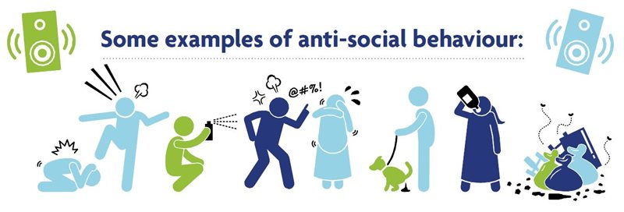
Defining antisocial behaviour
There is no clear, set definition of antisocial behaviour (or ASB)
Instead, ASB represents a continuum of behaviours, ranging from minor nuisances to more severe crimes (Carr and Cowan, 2006).
Notes:
This means definitions of ASB can change over time and place, and, some argue, can actually represent almost any behaviour which could annoy others (Carr and Cowan, 2006)

Slide 18
Defining antisocial behaviour
Antisocial behaviour (or ASB) is defined in policy as:
‘(a) conduct that has caused, or is likely to cause, harassment, alarm or distress to any person,
(b) conduct capable of causing nuisance or annoyance to a person in relation to that person’s occupation of residential premises, or
(c) conduct capable of causing housing-related nuisance or annoyance to any person.’ (Anti-Social Behaviour, Crime and Policing Act, 2014, pg. 2).

Slide 19
Migrant experiences of antisocial behaviour
Not discussed in research or practice in detail
Believed to be likely to be commonly experienced and that there is likely to be under-reporting of ASB
Impacts of ASB on migrants and their families not yet understood but likely to be severe and long-lasting

Slide 20
Research
Research Questions:
To what extent do refugees living in the Yorkshire and Humber region experience antisocial behaviour (ASB)?
How do experiences of ASB impact refugees and their families?
How can experiences of refugees/recently settled populations of ASB inform future research, policy and practice?
Methods
Literature and document search
Interviews with 20 migrants, refugees and asylum seekers on their experiences of ASB
Interviews with 7 stakeholders working with this population on experiences of ASB for migrants, refugees and asylum seekers
Notes:
Caveat – still in very early stages of data analysis so these are initial, indicative findings only

Slide 21
Understandings of ASB
The definition of ASB is unclear to migrants
We need to be careful how it is defined as there are lots of different definitions. And it surprised me that the [Local Council] website, UK Government website and Google all are different.
[Yuet, F, Migrant, Hong Kong]
Specific examples largely focused on extreme, criminal and racist or xenophobic behaviours, although there were some examples of minor annoyance or nuisance
Many migrants talked about behaviours in relation to the feelings they triggered
Words and actions or behaviours which make the other person feel uncomfortable, alienated and feeling like triggering a sense of unbelongingness
[Nathalie, F, Migrant, Mauritius]

Slide 22
Experiences of ASB (1 of 3)
ASB from service providers, professionals and police
People being very rude to you for no reason at all. Shopkeepers shouting. Shopkeepers behaving like you don’t speak English, like you’re an idiot or something
[Chun, F, Refugee, Hong Kong]
Some of the people who've got their refugee status now at the hotel are looking for housing in Leeds and are experiencing discrimination from housing providers because of their situation
[Hayley, Refugee and Asylum Seeker Support Worker]
One of them, they try to hit my wife and my children, and then my children, they was very young, very small. They were five and six years old. For that, we always have an afraid from the police
[Nassar, M, Asylum Seeker, Iraq]

Slide 23
Experiences of ASB (2 of 3)
Racist and status targeted behaviours
I think sometime it is clear that you experience something because you are a migrant
[Madiba, M, Asylum Seeker, Chad]
My friends try to tell me she is just rude as a person, it’s not you. But I increasingly don’t buy that, say, they are just rude because, as I told you, my partner is White. When I am with him or when I’m with his family, this kind of thing never happens. It’s only when I’m on my own or when I’m with my other migrant friends that this thing happens.
[Chun, F, Refugee, Hong Kong]

Slide 24
Experiences of ASB (3 of 3)
Unsafe neighbourhood
When I'm walking with people, they'll be like, oh, like I like living here. And this is, this is what I like. But like it all changes at night time. Like, that's that that seems to be like a shift that people talk about. So I think in terms of just like general kind of like feelings of safety.
[CJ, Charity Worker]
If you are in like a deprived area where there's a lot of that going on, it's difficult to know if someone's being targeted or if that is just the way they're behaving.
[Freya, Local Authority Project Officer]

Slide 25
Impact of ASB
Impacts of ASB were often cumulative, building on trauma from previous experiences
It is like we did something bad, but we did not do anything bad. Most of us are seeking protection because we come from countries that are from war. I think it is not good to treat people like this.
[Madiba, M, Asylum Seeker, Chad]
Feeling unsafe and powerless
It was not a good incident because I had, because I had trouble getting through it because I had to think of maybe tomorrow what would be there. The other thing could be somebody could just do something which is a little bit worser than yesterday. A lot of thinking and stress.
[Adaku, F, Migrant, Nigeria]
Feeling unwelcome and disillusionment with society
I felt bad because I was just telling myself, if this is how they behave, how will they treat me once I get the papers, you know? Have a come to the right place?
[Maria, F, Refugee, Kenya]

Slide 26
Impact of ASB
Changes in behaviour
e.g. moving house, no longer socialising with non-migrants, avoiding leaving the house/room in shared house
I had to think a lot and maybe try to change how I think and how I see people because you can't trust anybody. To be able to move on and know that such incidents occur.
[Adaku, F, Migrant, Nigeria]
It's just the reason that she moved to the other place so she could not stand living there anymore.
[Translator for Ganna, F, Refugee]

Slide 27
Impact of ASB (3 of 3)
Impact on health
It really affects children when they hear someone calling them names or asking them to leave. It just affects them mentally and make them consider really so they think they are unwelcome and unwanted.
[Ashor, M, Asylum Seeker, Undisclosed Nationality]
I also saw her in the beginning of the programme when she arrived from Ukraine, she was very confident. Yeah. Able to do things and that changed that changed to not being confident and not being able to cope with day-to-day life when she was subjected to ASB. So I've seen that change with my own eyes.
[Kavita, Local Authority Worker]
You know, his whole livelihood, his being, you know, his whole future is just being dramatically destroyed.
[Adriana, Counsellor]
Notes:
Stress, depression, anxiety and in some cases, life altering injuries from physical violence

Slide 28
Reporting ASB (1 of 2)
No action taken
Well, they were very snobbish. You know, when we inquired about the, of the investigation and when we noticed that that was how they wanted to respond to us, we had to just, you know, pull back a little bit
[Kalma, Migrant, M, Zambia]
One or two cases, they've actually gone to the police. But the police say, well, we’ll record it and where it happened and so on, but no action can be taken really.
]Julius, Charity Worker]
Experiences of racist and/or xenophobic attitudes and behaviours from police
He's regularly, regularly encountered real harassment from the police as well as the neighbours
[Adriana, Counsellor]

Slide 29
Reporting ASB (2 of 2)
Migrant treated as offender/suspect
[The police] brought him [partner] to the station, and he explained what happened and they said you lost your patience. And he asked if they could take him to the hospital but they kept him in the station... At 04.00 o clock my husband was screaming and asked please can I go to the hospital? So he went to the hospital, they took the X-ray and all the test and confirmed that he was broken.
[Belinha, Migrant, F, Portugal]
Occasional examples of good outcomes led to increased trust in police and services and a reported increase in likelihood of reporting issues in the future
Anything that happens, try report it to the police because the police are here to protect lives and property, definitely. And from the police, let them ask and tell them… this law is for everybody no matter who you are.
[Famous, Migrant, M, Gambia]

Slide 30
Barriers to reporting ASB
Negative perceptions of police and services
You know, when you are an asylum seeker, you really avoid issues. There’s some things you try not because in one way or another you don’t want to get involved in the authorities
[Lea, F, Asylum Seeker, Undisclosed Nationality]
Language barriers and lack of information
If you are like an asylum seeker and you know that you don’t need to have problems and you don’t even want to complain. Because of the language barriers and you don’t know your rights exactly as you are new [in the country]
[Madiba, M, Asylum Seeker, Chad]
Keeping to self, and gratitude to society
I feel grateful, I feel thankful and I think this country and the people give us the chance, and I left Hong Kong, I don’t want to mess up and learn the bad things
[Yuet, F, Migrant, Hong Kong]

Slide 31
Some positive messages
People who were in touch with charitable services largely had positive experiences with them, including feeling welcomed, supported and informed
Some people reported liking the areas or communities they lived in, had close relations with immediate neighbours or other migrants in the area
People valued their voices being heard and their stories being viewed as important, and this was the ‘main point’ people gave in the majority of participant interviews

Slide 32
Reflections from community researcher
Jack Liuta, Migration Yorkshire

Slide 33
Summary
Migrants appear to regularly experience antisocial behaviour, ranging from low level to often more serious behaviours and crimes
The impact of antisocial behaviour can be longstanding and contribute to mental health challenges and distress, fear and alienation
Whilst some reports of antisocial behaviour are responded to effectively, many migrants do not report the behaviours they experience or are not treated well when they do so.
Offering safe spaces to migrants to share their experiences and/or report antisocial behaviour may help with tackling this issue
Notes:
Thank you to Jack and Migration Yorkshire

Slide 34

Dr. Kirsty Cameron – kirsty.cameron@leedsbeckett.ac.uk
Please provide feedback using the QR code or the following URL: https://forms.office.com/e/7yY7AYNfzg

Slide 35


Community cohesion: Lessons from research
Lucy Mort – Senior Research Fellow

Slide 36





What do we mean by community cohesion?
A complex concept: Defining cohesion is often not straightforward. Often described as a process rather than a destination.
Related concepts: Sometimes overlaps with terms like social cohesion and community resilience.
In a cohesive community, people:
Experience wellbeing, have a sense of belonging and a wish to contribute voluntarily to the good of society.
Value diversity, are tolerant and promote multiple values and cultures.
Enjoy equal opportunities: Have equal rights and access to opportunities to thrive (Fonseca et al 2018).
Notes:
We all probably have a view or concept of what is meant by community or social cohesion, but it has been notoriously difficult to pin down a definition over the years. I don’t necessarily want to get bogged down into defining it, but there are values and principles that tend to re-occur.

Slide 37



Challenges to cohesion
Structural inequalities: Economic and social inequality, racial tensions, and growing polarisation are straining cohesion.
Narratives about migration: Far-right and divisive narratives about migration exacerbate tensions and mistrust. They give easy answers to complex issues and can be aired far and wide on social media.
Immigration and asylum policies hinder cohesion, such as:
A centralised asylum system that disregards local factors when placing people in accommodation.
Long routes to settlement deny rights and hinder opportunities for integration and participation in communities.
Insufficient support for cohesion: A lack of political focus and inadequate funding for cohesion & integration initiatives leave communities unsupported.

Slide 38
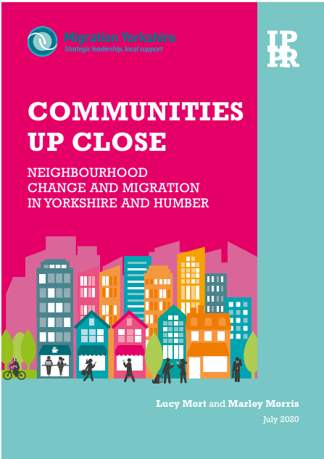
Insights from Yorkshire – perceptions of migration
Large-scale research: Spoke to ~250 people across Yorkshire, exploring their views on migration and its impact on local areas.
Key findings:
Areas with recent, higher levels of migration, alongside poverty and insecure labour markets, often see more scepticism towards migration.
Broader concerns about economic decline and changes in neighbourhood identity often intertwine with attitudes toward migration, contributing to tensions.

Slide 39
What drives acceptance & connection?
Migration histories: Areas with longer histories of migration tend to show greater acceptance, as migration is woven into their identity. Limited historical exposure to migration can foster resistance to change.
Building connections: Lack of shared spaces and opportunities for interaction between communities hinders meaningful relationships.
Solutions: Community-led initiatives foster integration and a sense of belonging. But it’s also vital to invest in things like English language support and countering misinformation.

Slide 40

Deepening social connections
Aims: Practical toolkit to help combat social isolation, forge social connections and promote social cohesion.
Five areas for action:
Holding activities that bring people together.
Creating public spaces and infrastructure that work for communities.
Investing in inclusive education, skills and training to empower individuals and integration.
Including diverse communities in decision-making to ensure solutions are locally relevant and representative.
Transforming systems through:
Joined up working
Tackling discrimination, prejudice & hate crime
Trauma-informed approaches.
Notes:
Follow up project that looked in more depth at what local policymakers and organisations could do to foster social connections within and across communities.

Slide 41
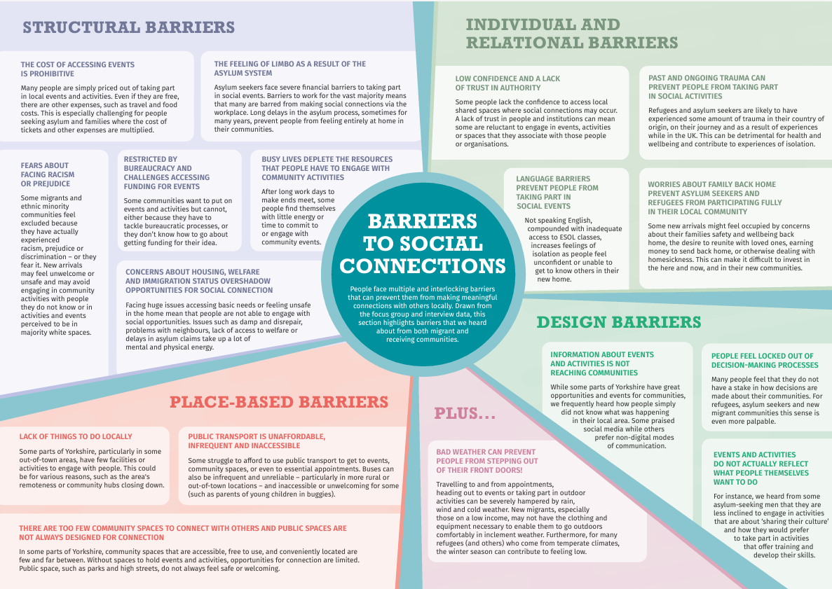

Slide 42
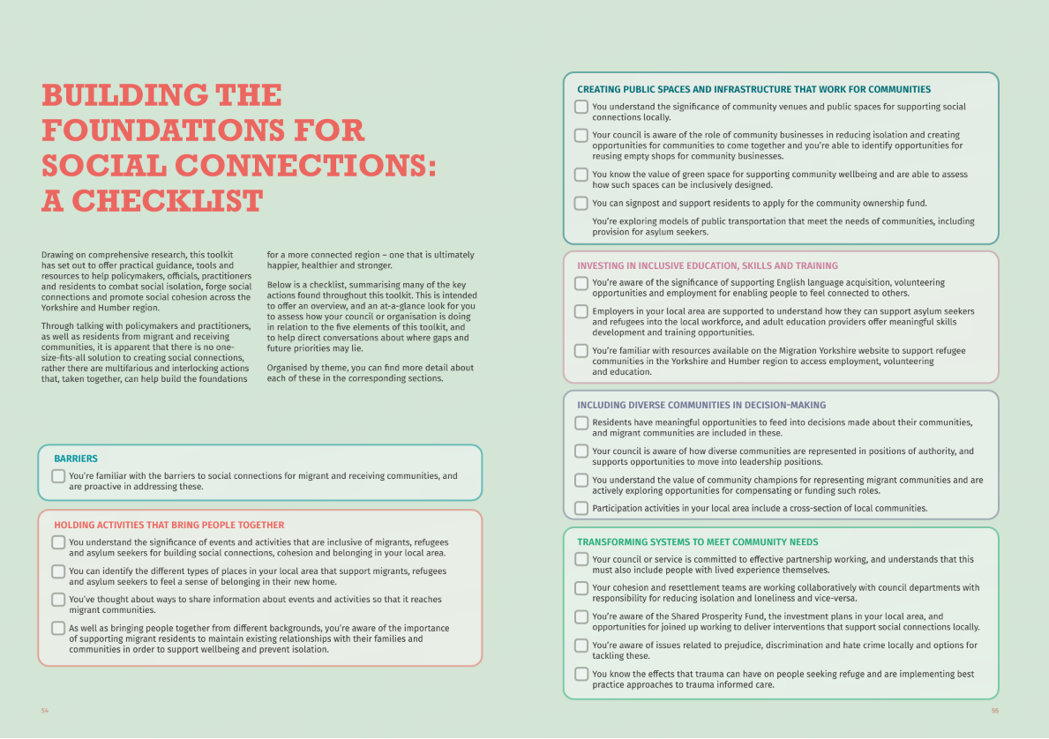

Slide 43
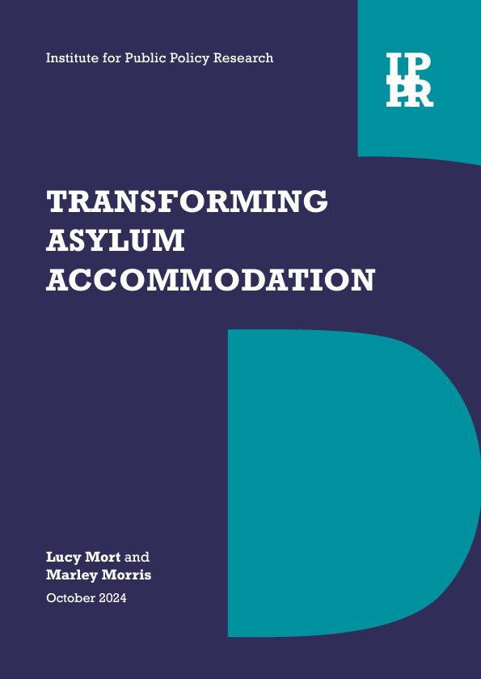
Asylum policy and cohesion
Tensions and far-right activism: Highly visible and politicised accommodation like hotels attracts far-right activism, creating flashpoints for tension and heightening public scrutiny.
Lack of local agency: Councils currently have limited say in where people seeking asylum are placed, undermining their expertise in maintaining community cohesion.
Missed integration opportunities: Long stays in unsuitable accommodation, coupled with inadequate resourcing, prevent asylum seekers from learning English, developing skills, and building connections within their communities.
The case for decentralisation: Local bodies, with a vested interest in community cohesion, are better placed to deliver tailored solutions and avoid reliance on hotels, reducing risks of social tension and fostering integration.
Notes:
Our recent report on transforming asylum accommodation outlines how asylum policies deeply undermine community cohesion. While councils do have some input, their say in where asylum seekers are placed is quite limited, and their local expertise in maintaining cohesion and understanding community dynamics is routinely undermined.
As we’ve seen recently, highly visible accommodations like hotels often become targets for far-right activism. This doesn’t just create tension—it can lead to terrifying acts of violence. Additionally, long stays in unsuitable hotels and large sites prevent asylum seekers from rebuilding their lives—whether that’s learning English, gaining new skills, or building meaningful connections within the community. And even when connections are formed, people are often moved to a different part of the country, forcing them to start all over again.
It’s clear that the current approach is costly, ineffective, and fails to meet the needs of both asylum seekers and local communities. To build a system that truly works for everyone, we need to put control in the hands of those who understand their communities best.

Slide 44
Where are we now? – The political landscape
Post-riots focus on cohesion:
Greater political awareness of the need to tackled far-right extremism and foster community resilience.
Momentum building for policies that address local tensions and prevent unrest.
MHCLG have made £15 million available under the Community Recovery Fund for communities affected by rioting.
Opportunities under the new government:
Increased focus on devolution and empowering local leadership.
Potential for a national cohesion strategy?
Challenges to overcome:
Ensuring political will comes from the very top and translates into action and adequate funding.
Embedding cohesion as a cross-departmental priority – including in the Home Office - rather than a siloed issue for MHCLG.
Next steps for policy:
National government must set the tone but empower local leadership.
Investment in places and people to promote cohesion and tackle inequalities.

Slide 45
The role of the VCS and working together
Key contributions of the VCS:
Delivering projects that foster welcome and integration in communities.
Advocating for community needs and amplifying diverse voices.
Bridging gaps between local authorities, national government, and marginalised groups.
Collaborative approach:
The VCS can work alongside local and national government to design inclusive strategies.
Encourage dialogue and promote accurate information to counter misinformation and foster trust.
A call to action:
Work together to ensure community-led solutions are integral to policy development.
Notes:
There are so many inspiring examples of the voluntary and community sector working on this issue across Yorkshire and the Humber. In our research, we spotlighted some incredible initiatives, from Who is Your Neighbour to the Millside Centre Refugee Café in Bradford, and the Jo Cox Foundation. These organizations—and every organization represented here today—play a vital role in helping communities come together, fostering connection, and building resilience, rather than allowing them to come apart.

Slide 46
What are your every day approaches to cohesion?

Slide 47
What are your every day approaches to cohesion?
What do you do now?
What worked well? How do you know it's worked?
What would you like to do?

Slide 48

How can we, and why should we, effectively get our messages across?
Tina Brocklebank, Bradford City of Sanctuary
Aidan Melville, Migration Yorkshire

Slide 49
Aims
To provoke questions that will help you in your role/organisation identify the who, the why, the how and the how do you know if you've been successful?
For us to identify where the knowledge gaps are so we can identify needs and develop further workshops/training/signpost to resources.

Slide 50
Who?
Who are your audiences – the people you want to communicate or engage with?

Slide 51
Why?
Why are you communicating with these groups?

Slide 52
More influential
(or useful)
Less influential
(or useful)
Less interest
More interest

Slide 53
How? (Technically)
How are you going to communicate your message? What platform, comms channels, strategies will you use?

Slide 54
How? (Content-ly)
What style, language, tone, will you use?

Slide 55
How do you know if you've been successful?
How can you measure if you have effectively communicated your message to your identified audience?

Slide 56
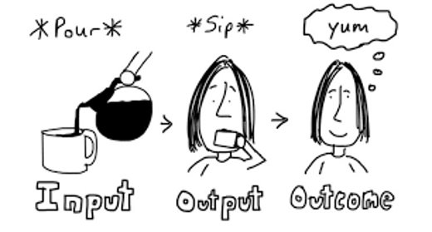

Slide 57
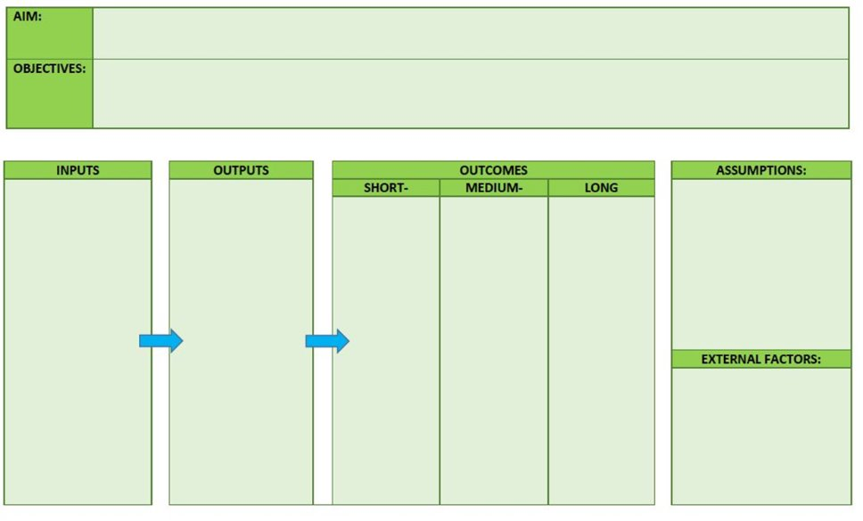

Slide 58
What next?
Where are the knowledge gaps, what else did you want to learn from this activity? What other information do you need now to take this forward?

Slide 59



Aging out:
How the ‘transitional safeguarding’ approach may support work
with adolescents and young adults
Dinah Beckett – Migration Yorkshire
Ewan Galbraith – Refugee Council

Slide 60
What is transitional safeguarding?
It is about the transition from childhood to adulthood, which is a journey not an event.
It recognises the nature of risk and harm changes through adolescence and into adulthood.
And that every young person experiences their transition into adulthood differently, at different ages, according to their individual circumstances, life history, experiences and maturation
The transitional safeguarding approach applies to young people aged mid-teens to mid-20s.

Slide 61
What is transitional safeguarding?
It is not simply about the transition from children's services to adult services (ie handing over a file) it's about supporting young people as they navigate the complexities of reaching adulthood and providing a needs-led, personalised approach
For young people under 18, safeguarding duties are intended to protect all those at risk of harm. Adult safeguarding focuses on people with care and support needs who might find it more difficult to protect themselves from abuse or neglect. This can restrict/limit the statutory response
It requires practitioners, leaders etc to consider how they might work together and think beyond child/adult silos for the benefit of young people at a key life stage

Slide 62
Why is it important in our work?
People seeking asylum are predominantly young. In 12 months to June 2024, 62% of asylum claims were made by people aged under 29
Biologically, the transition into adulthood continues until our early to mid-20s
age | 2023 Q3 | 2023 Q4 | 2024 Q1 | 2024 Q2 | total
30+ | 7,794 | 7,145 | 6,775 | 7,227 | 28,941
18 to 29 | 12,479 | 9,756 | 9,385 | 10,316 | 41,936
under 18, UASC | 1,933 | 903 | 950 | 995 | 4,781
 | 22,206 | 17,804 | 17,110 | 18,538 | 75,658
Many young people are caught up in age disputes, this means they may be children being treated as adults and not receiving the care and support they are entitled to
Young people who are 18+ receive radically less support than those a few months younger. This differing support is not reflective of need/maturity/ability to live independently etc
Other sectors have more nuanced transitions for young adults

Slide 63
Young People
Why is it important in our work?
Asylum Seeker/Refugee
Still maturing and developing
Riskier behaviour, experimentation
More easily influenced
Searching for identity
Aspirations and hopes for the future
May struggle more to interact with bureaucracy and professionals
Language barrier
Lack of education
Trauma
Not understanding systems
Insecurity of asylum status
Lack family and support networks
No documents
Isolation: lack of family and social network

Slide 64
Case Study 1
YP arrives in the UK after a journey of several years and is assessed as 18+ at port and routed into adult system.
After some weeks in the UK, he is age assessed by an LA and found to be 17, turning 18 in a few weeks.
He is taken into care, only to be returned to the adult system when he turns 18 (due to 13-week threshold) and is dispersed away from the area even after having made local connections.

Slide 65
Challenges/Impacts
Experience not being believed (on arrival)
Significant disruption from being bounced between adult and children’s systems (college, placement, solicitor, friends)
Continues in adult system at youngest possible age

Slide 66
Case Study 2
YP arrives and is supported by children’s social care.
He speaks an unusual language and there is not much of his community around. He struggles to learn English.
His asylum application is granted, and he turns 18 with care leaver status. He is then moved from shared accommodation to his own tenancy and expected to become more independent.
Tragically, after some time living independently and becoming increasingly isolated, he takes his own life.

Slide 67
Challenges/Impacts
Cultural isolation, language isolation, social isolation
Unemployment, not in education or training
Shame at not reaching significant milestones (marriage, job)
Depression
Being granted refugee status and being in care/care leaver status do not mean the end of a young person's problems.

Slide 68
Case Study 3
YP is described by professionals as difficult and not engaging with support. He wants to change placement and has absconded to friends' houses in a different city on several occasions. The social worker tells him his expectations are too high.
After working with the young person, it becomes clear that SW often has conversations with him without an interpreter.
It also becomes clear that the young person is more willing to accept decisions if he is explained how and why these are made and how systems in the UK work.
In first session says that no one has ever explained things to him calmly and patiently before.

Slide 69
Challenges/Impacts
The social worker justified not using interpreters as him needing to practice and improve his English but it meant he didn't understand what was being said.
YP experiences frustration due to language barrier and lack of understanding of systems
Attitudes of professionals not child centred or curious. Young asylum seekers are often treated as older than they are by professionals
Self-fulfilling prophecy ‘difficult’

Slide 70
How can you apply the transitional safeguarding approach to your practice?
Consider if your services are replicating the artificial barriers in statutory services
Talk to your funders – can there be greater flexibility in eligibility criteria?
Understand the rules and processes around age disputes and consider how your organisation can navigate to meet the needs of young people caught up in the process.
Familiarise yourself with the legislation to assist conversations with statutory services.

Slide 71
References for further information on transitional safeguarding
Research in Practice Transitional Safeguarding: A Knowledge Briefing for Health Professionals, October 2023
Dept of Health and Social Care Bridging the gap: Transitional Safeguarding and the role of social work with adults, June 2021

Slide 72
How can we enable the transition to e-visas?

Slide 73

How can we enable transition to the eVisa Scheme?
27th November 2024

Slide 74
What is the Evisa Scheme?
The benefits of eVisas include:
They are secure and cannot be lost, stolen or tampered with, unlike a physical document
You will not need to wait for, or collect, a physical document after your application is decided – you might still need to provide biometric information in person, and we will tell you if you need to do this
It will be quicker and easier to prove your status at the UK border, and share your status with third parties like employers and landlords
UK eVisa Scheme Overview
Key Features:
Digital application process for visas.
Biometric verification for enhanced security.
Fast-track decision-making for efficiency.
Online tracking for application status updates.

Slide 75
Operational Challenges
Application process complexity
The eVisa application process can be cumbersome, with multiple steps that often confuse applicants.
Processing delays
Extended processing times are a common issue, causing inconvenience for travelers needing quick approval.
Resource constraints
Limited resources in visa processing facilities lead to slowdowns and inefficiencies in handling applications.

Slide 76
Technical Challenges
Technical malfunctions
Frequent website outages and system errors disrupt the application process, frustrating users.
Data privacy issues
Ensuring compliance with data protection laws like GDPR is a complex task for the eVisa platform.
Security concerns
There are risks of data breaches, posing challenges to secure sensitive applicant information

Slide 77
User Experience Challenges
Confusing guidelines
Applicants often find the application instructions unclear, leading to errors and frustration.
Lack of multilingual support
Limited language options restrict accessibility for non-English speakers, affecting inclusivity.
Accessibility concerns
Insufficient provisions for individuals with disabilities make the application process challenging for some users.

Slide 78
User Experience Challenges
Changing eligibility criteria
Frequent adjustments to eligibility impact applicants and make it hard to keep up with requirements.
Complex appeal processes
Applicants face difficulties navigating the appeal process if applications are denied.
Policy inconsistencies
Inconsistencies in policy interpretation lead to confusion and varying outcomes for similar cases.

Slide 79
Policy and Regulation Challenges
Changing eligibility criteria
Frequent adjustments to eligibility impact applicants and make it hard to keep up with requirements.
Complex appeal processes
Applicants face difficulties navigating the appeal process if applications are denied.
Policy inconsistencies
Inconsistencies in policy interpretation lead to confusion and varying outcomes for similar cases.

Slide 80
Solutions and Recommendations
Streamline application process
Implement clearer guidelines and simpler steps to make applications more user-friendly.
Enhance technical infrastructure
Improve platform security and functionality to minimize outages and ensure data protection.
Increase accessibility
Provide multilingual support and accessible design to serve a wider range of applicants.

Slide 81
Challenges
What other challenges or barriers have you or partner organisations
faced?

Slide 82
Solutions
What other systems or processes should be in place to enable the eVisa transition?

Slide 83
Next Steps
Consolidate feedback and share

Slide 84
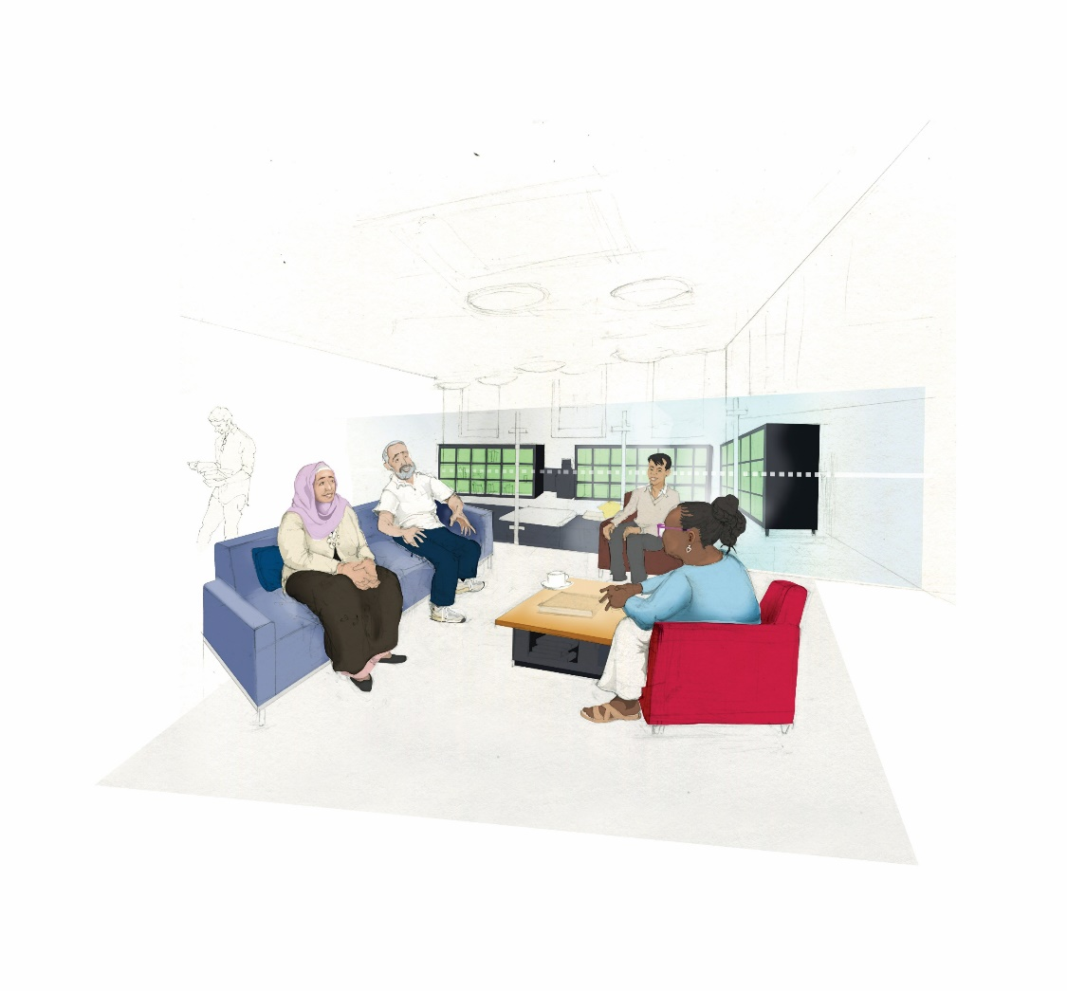
How can we collectively ensure ESOL provision is recognised as a key part of belonging?
Emma Taylor, Migration Yorkshire, ESOL Regional Lead
Mary Begley, MESH Development Worker / Project Worker
27 November 2024
All Illustrations by Nick Ellwood

Slide 85
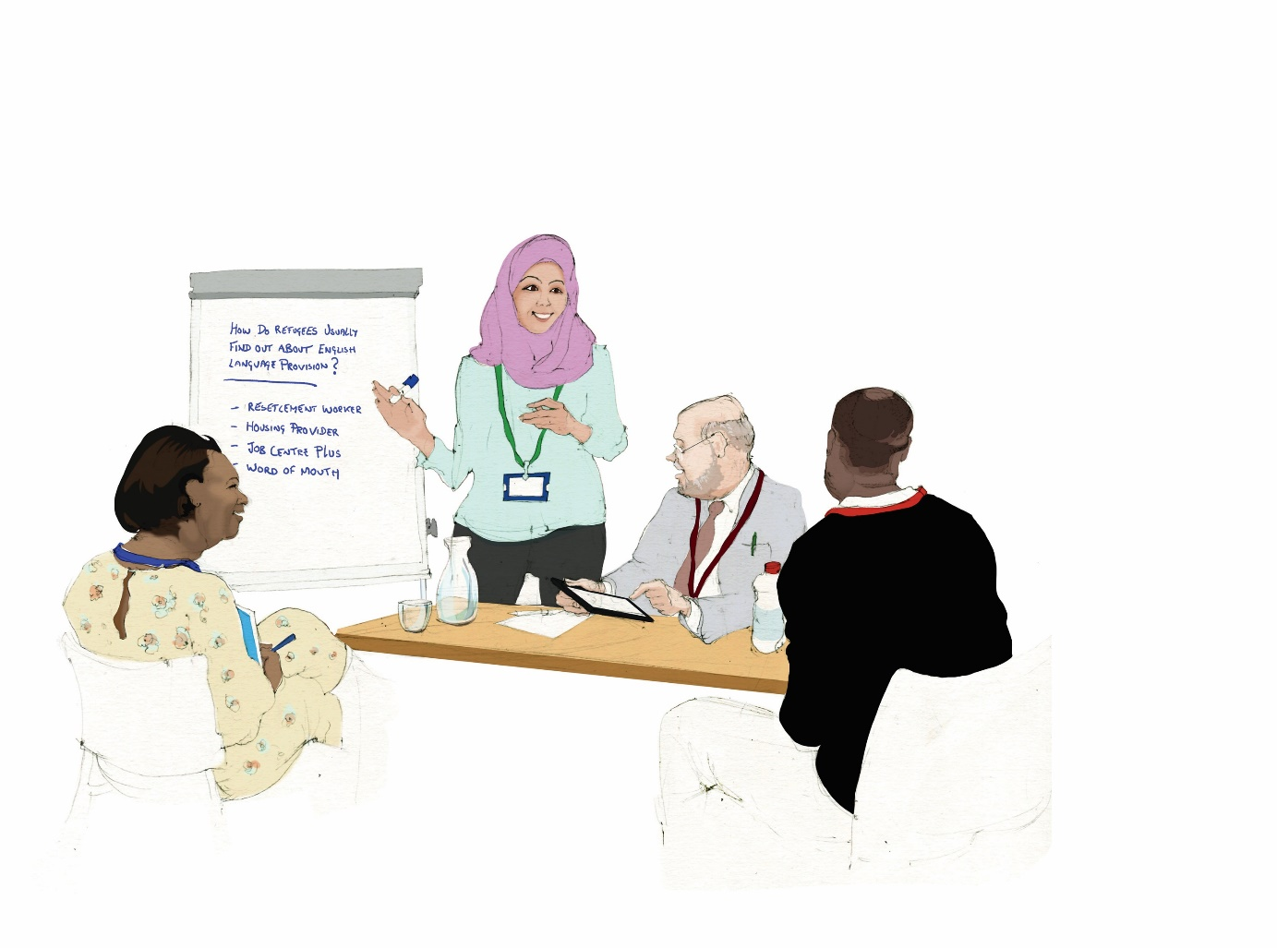
How can we collectively ensure ESOL provision is recognised as a key part of belonging?
12.15 – 13.00
Mary – MESH Introduction
Emma – Migration Yorkshire Introduction
Belonging – Group Activity
Belonging – Context Setting
Regional Examples
Your influence

Slide 86

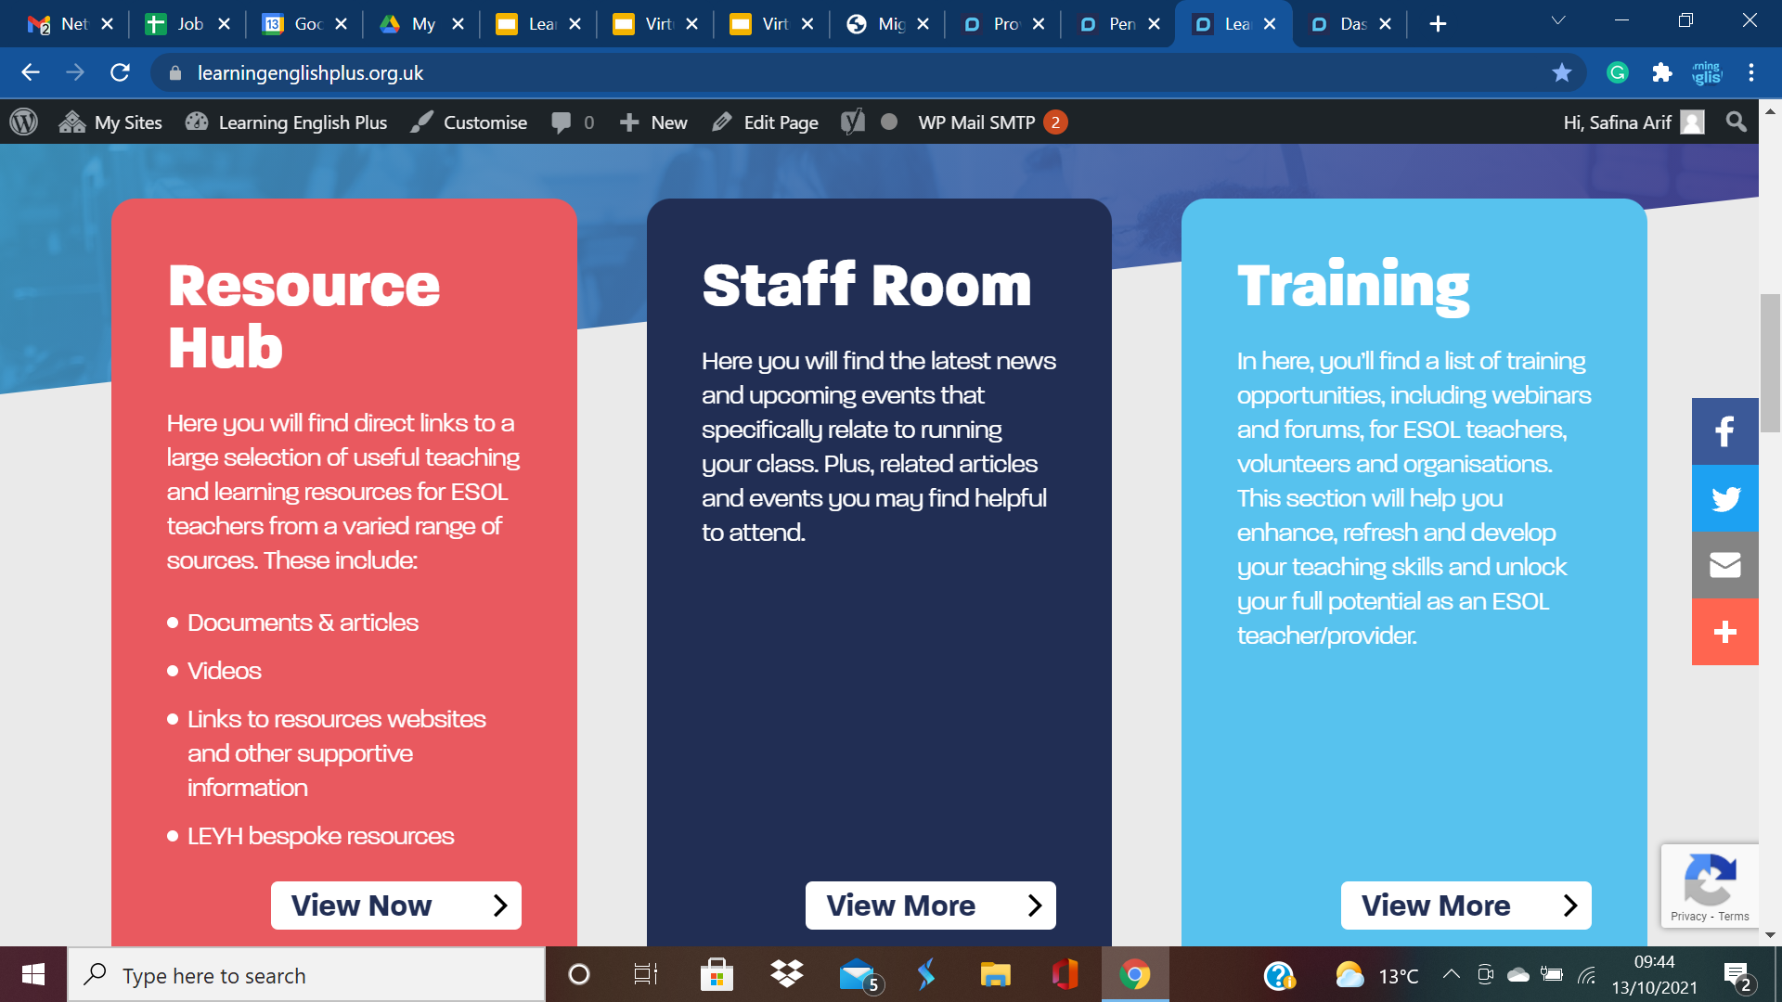



MESH Website Update
Notes:
Clare

Slide 87
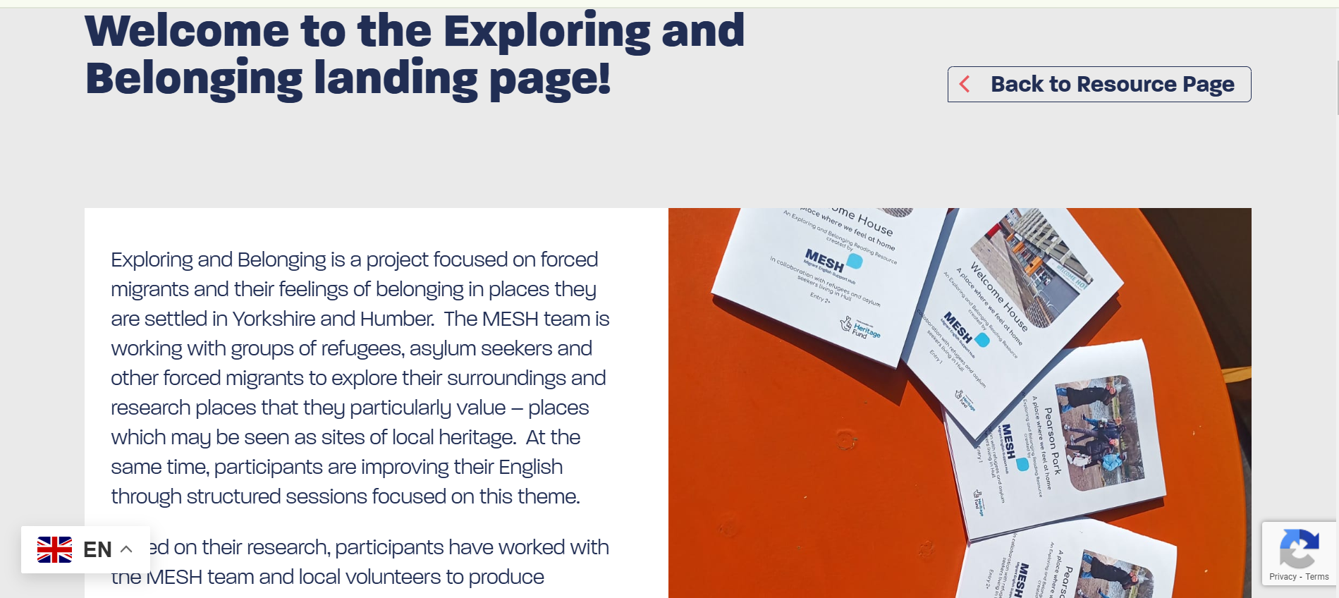

Slide 88
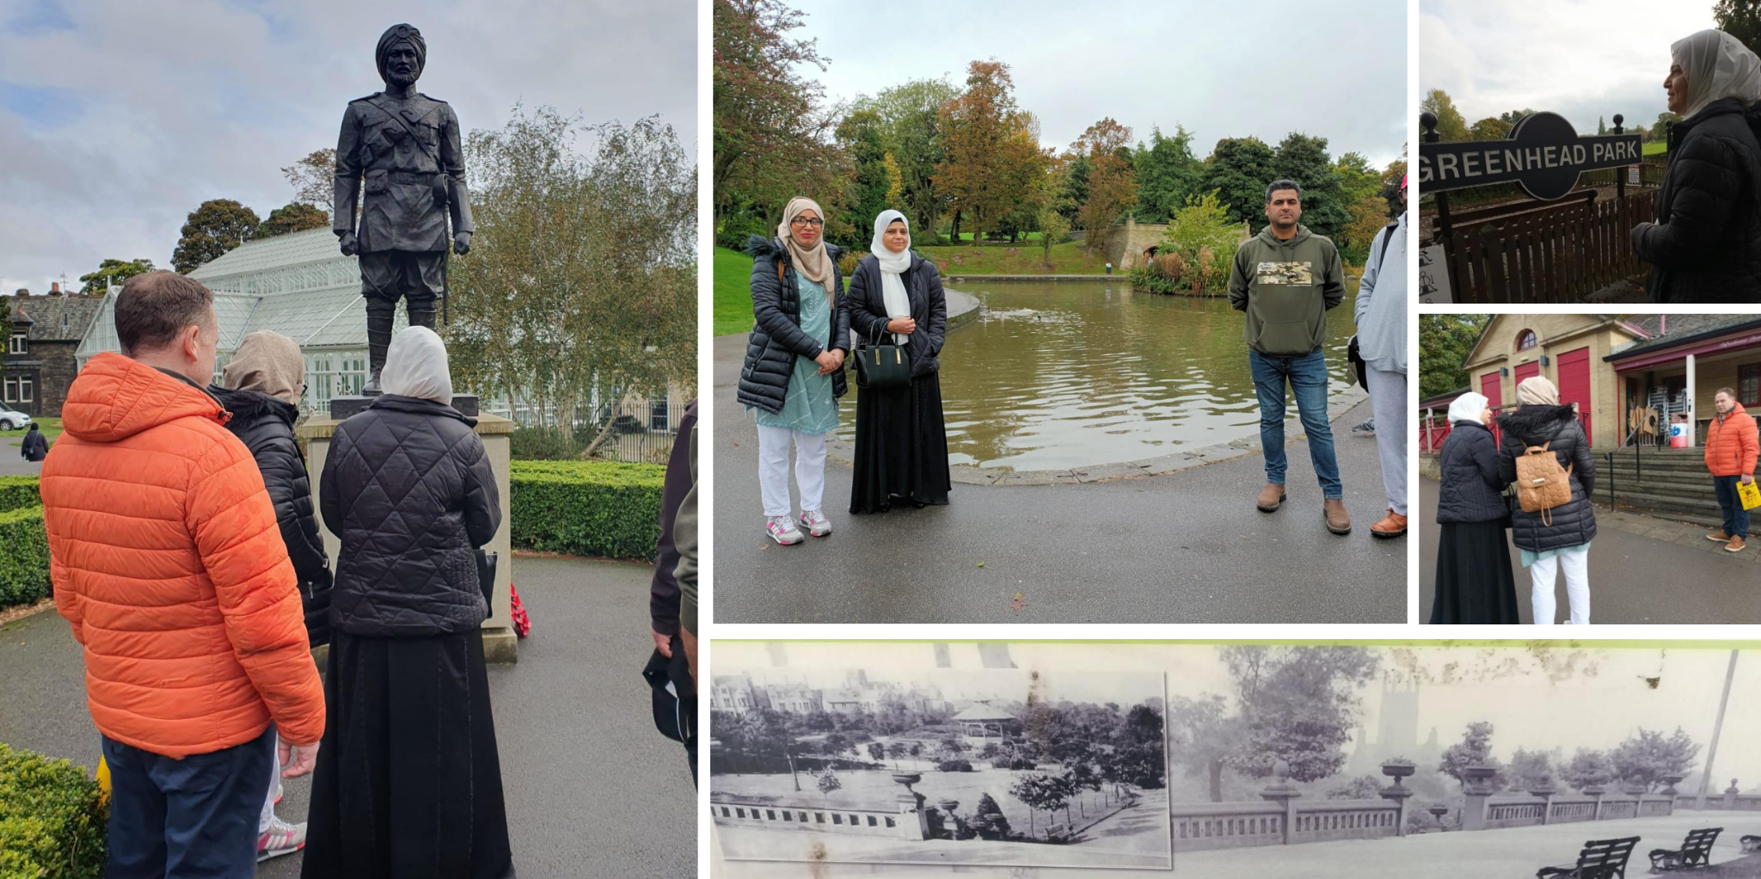

Slide 89
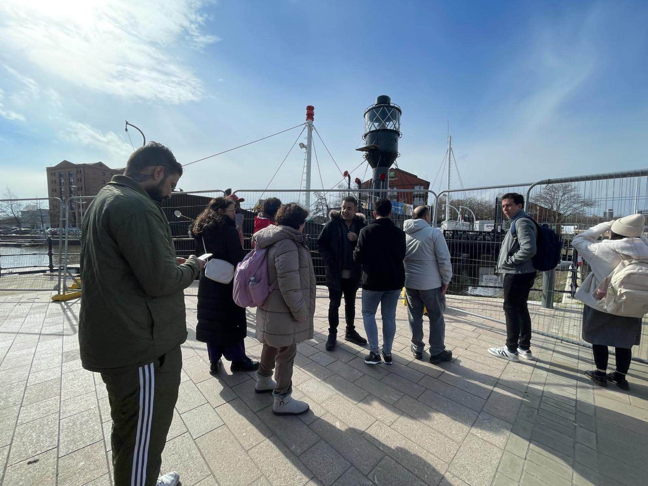

Slide 90
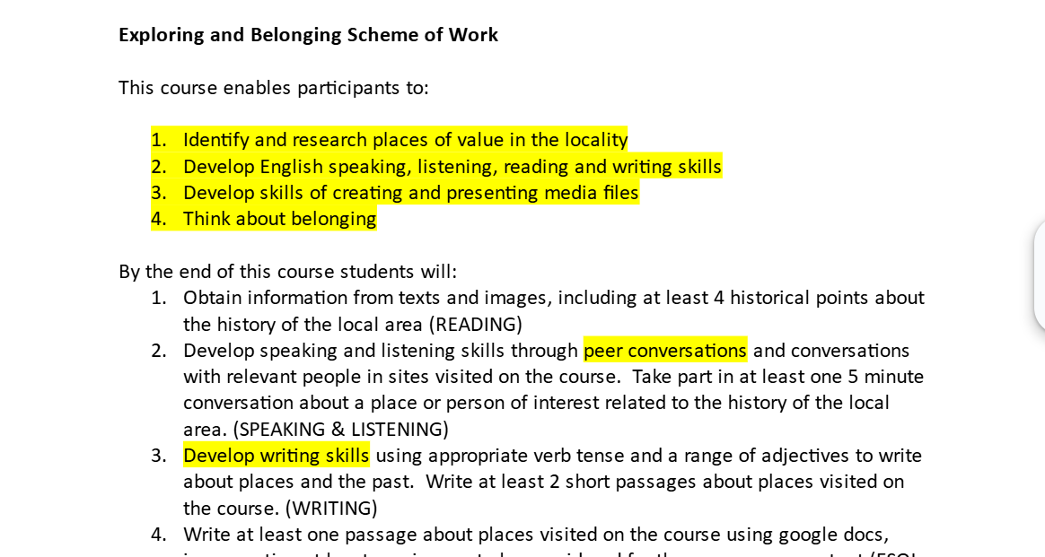

Slide 91
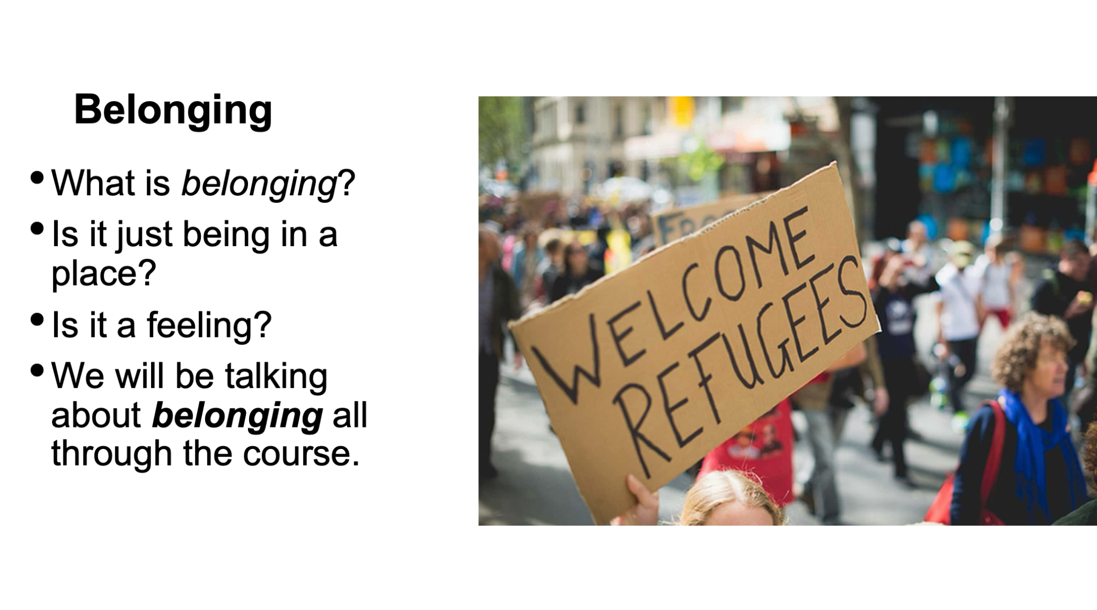

Slide 92

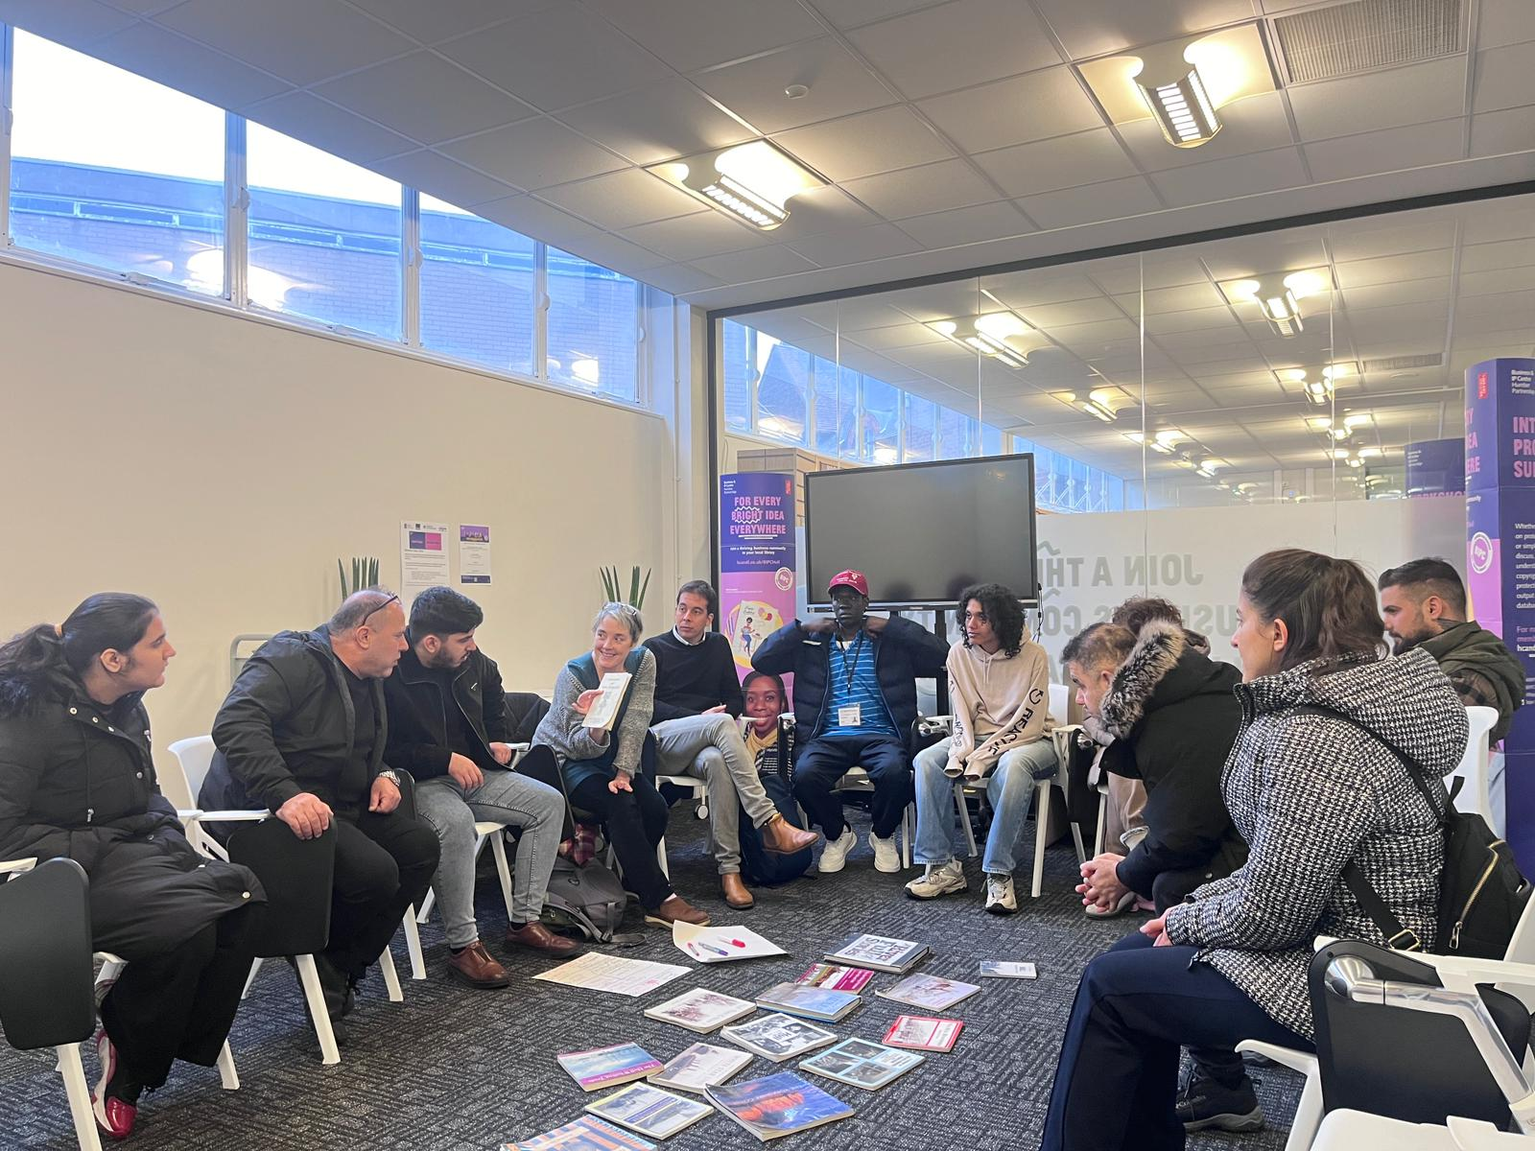
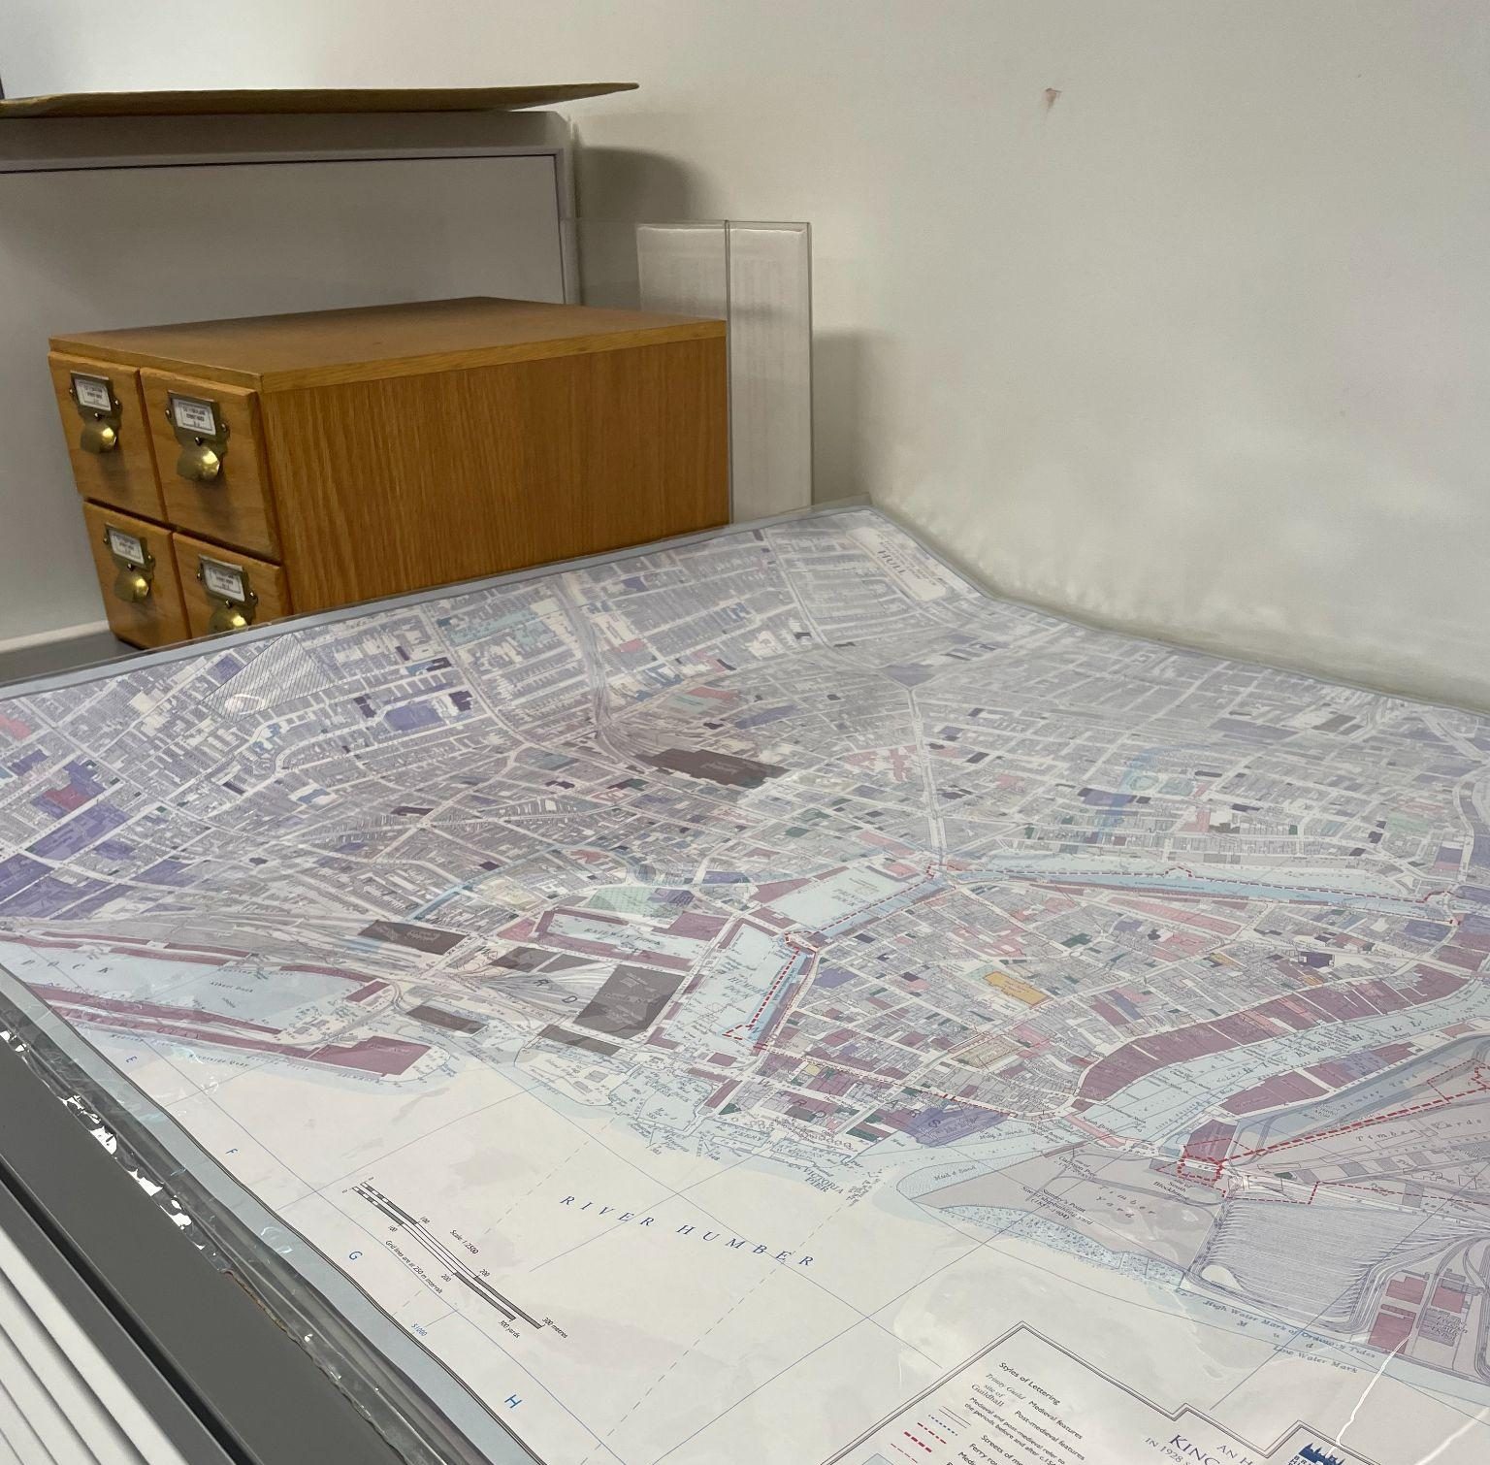

Slide 93
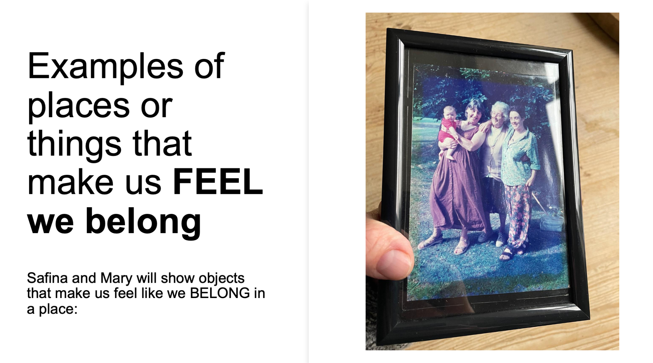

Slide 94
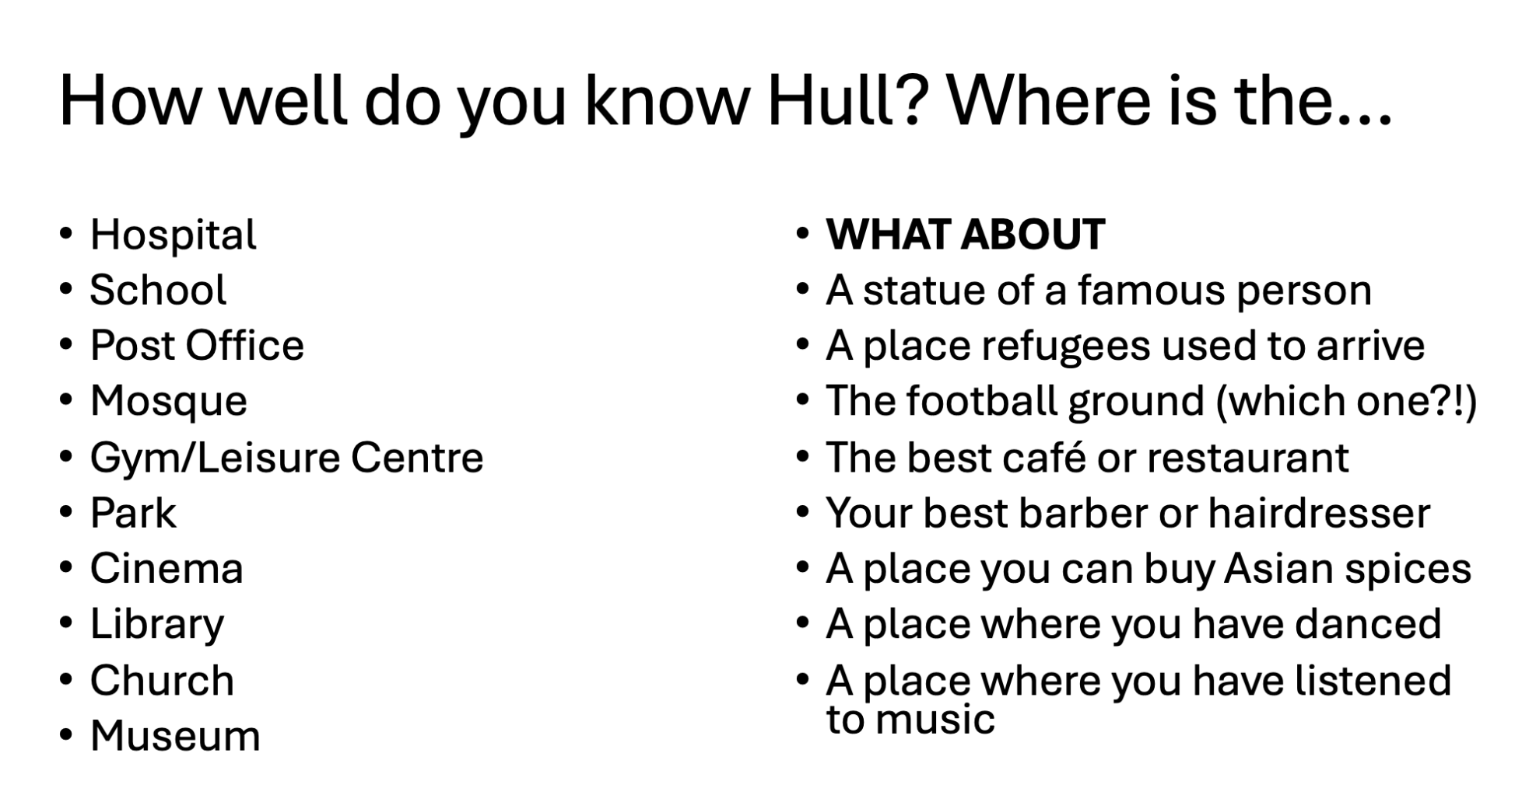

Slide 95
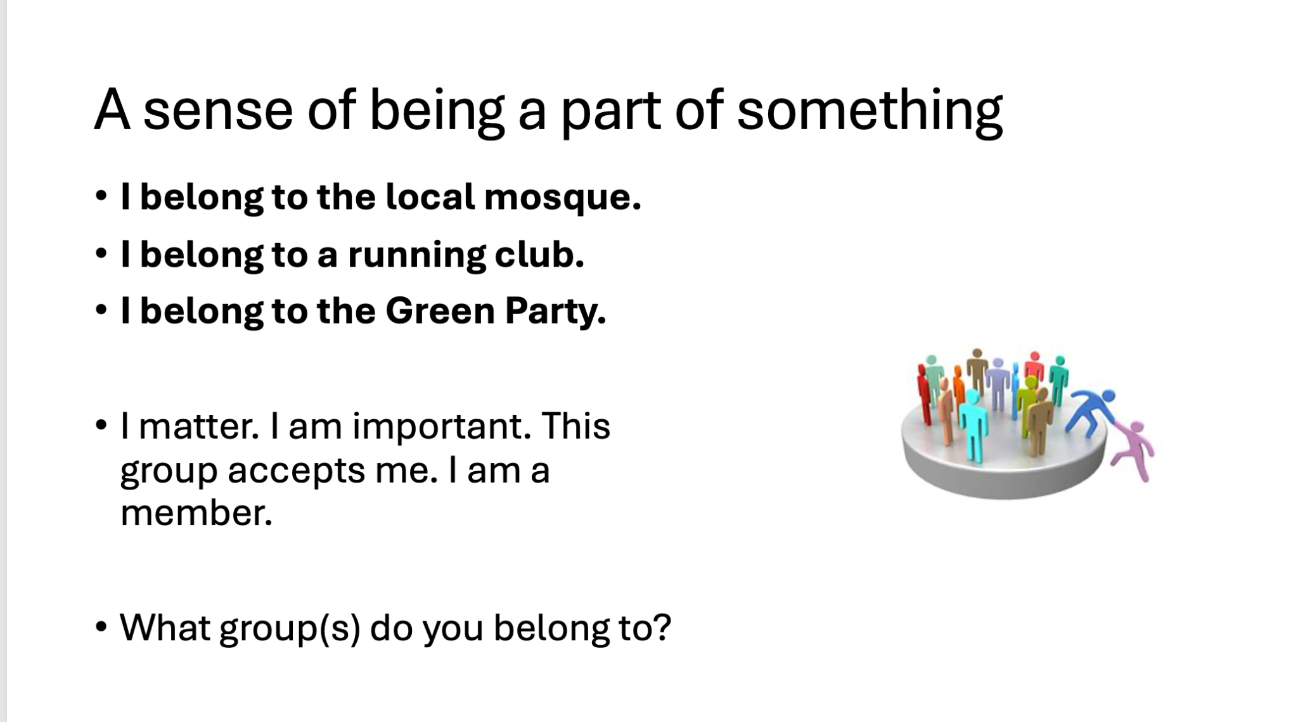

Slide 96
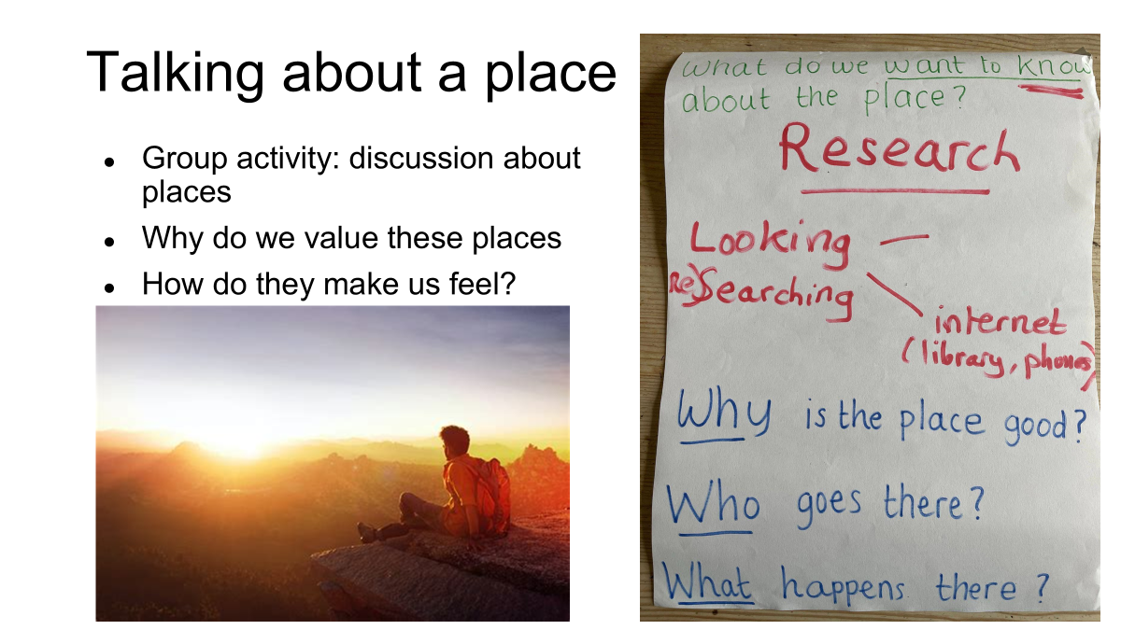

Slide 97

Ammar’s experience on the project

Slide 98

Migration Yorkshire emma.taylor@migrationyorkshire.org.uk
Role of ESOL Regional Coordinator
ESOL for refugees: a toolkit for commissioners and practitioners | Migration Yorkshire
ESOL Needs Analysis and Placement for Refugee Learners: a toolkit for providers | Migration Yorkshire

Slide 99
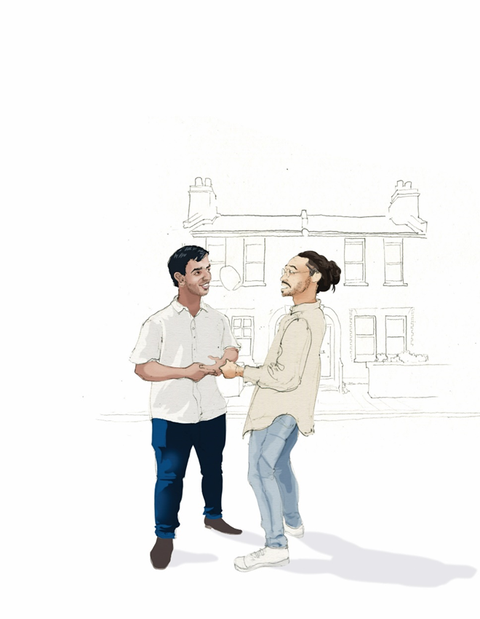
Belonging
Belonging. What do you need to feel like you belong in a community?

Slide 100
Context Setting – ESOL & Belonging
How do we embed, champion, facilitate, explain, show the value of...?

Slide 101
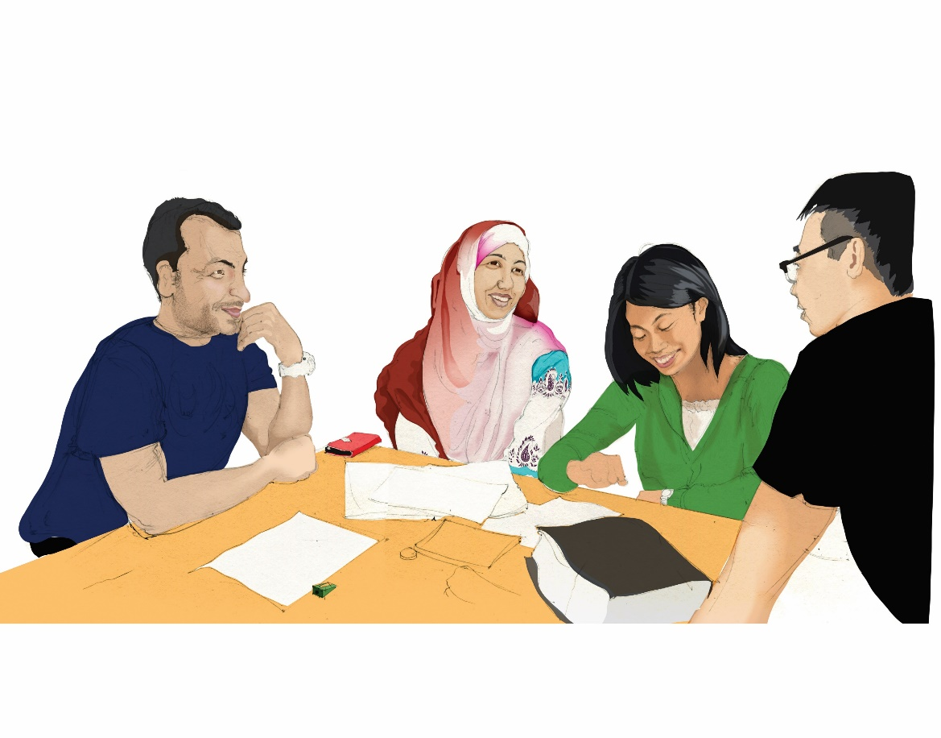
Examples of how ESOL is embedded (or not)
Positive or negative examples from your organisation or community of how ESOL can or is embedded.

Slide 102

Does your organisation recognise ESOL as a key part of belonging?
Give examples of how it does or doesn't…
What can YOU do to influence?
What can you take away from this workshop?

Slide 103
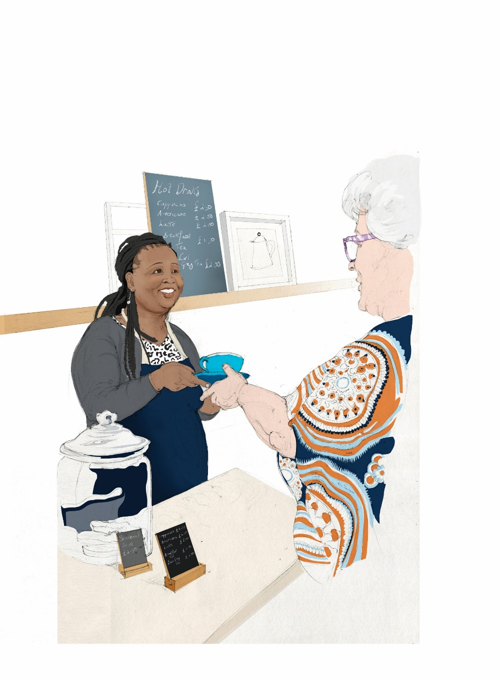
Comments

Slide 104
Self-Care and Vicarious Resilience – what is it and why is it important?

Slide 105


WELCOME
'Self-care & vicarious resilience'
What is it & why is it important?
Kathryn Ashworth - Mat Sidebottom - Vanessa Lendzionowski

Slide 106
Aim workshop
To consider the impact of your work on your wellbeing,
to understand the different types of impact,
and practical ways,
to mitigate the risk and improve your resilience.

Slide 107


Who is here today in the room?
(different organisations, roles)
There may be people who have experience of trauma and or the asylum process and talking about it can be difficult
(so do please do what you need to look after yourself)
Who has felt stress? How do you know when you are stressed?
This Photo by Unknown Author is licensed under CC BY

Slide 108


Definitions
Stress: a way we respond when we feel under pressure or when we can’t handle everything we need to do. A condition or feeling experienced when we think the demands on us will be too great.
Burnout: a state of emotional, physical and mental exhaustion caused by excessive and prolonged stress. It occurs when you feel overwhelmed, emotionally drained, and unable to meet constant demands. It does not require there to be any involvement with trauma or traumatic material.
Compassion Fatigue: a condition characterised by emotional and physical exhaustion gradually leading to a diminished ability to empathise or feel compassion for others.
Vicarious Trauma: The cumulative transformative effect on the helper of working with survivors of traumatic life events. A state of tension and preoccupation with the stories/ trauma experiences described by clients. It can mirror the symptoms of trauma\PTSD as well as aspects of compassion fatigue and burn out.

Slide 109

Focussing on prevention
but still helpful to identify some risk factors:
Not setting, or ignoring boundaries
Inadequate support
Personal traumatic history
High levels of personal stress
Additionally, for workers/volunteers with personal experience of the issues faced by the people they are supporting :
Cultural expectations and being part of the same community?
Speaking the same language
Expectations of colleagues as well as the people you are helping
Hard to leave work at work
Similar personal experiences – housing, employment, immigration status
Ongoing personal trauma – fears for safety of family, racism
Being asked for help outside work/ volunteering role

Slide 110

Possible responses
Negative:
Vicarious traumatisation
Burnout
Compassion Fatigue
Neutral:
Impact is managed effectively – your experience, support and resilience enable you to cope with the impact of the material
Positive:
Vicarious Resilience - we draw inspiration from a client's resilience that serves to build our own.
Compassion Satisfaction - reflects the sense of meaningfulness that is gained from our work.
Each one of these positive outcomes can motivate us and, in turn, protect us against the negative effects of trauma exposure.

Slide 111

The Impact of Vicarious Resilience
Greater perspective and appreciation of own problems
More optimistic, motivated, effective and re-energized
Increased sense of hope, understanding, and belief in the possibility of recovery from trauma and other serious challenges
Profound sense of commitment to, and finding meaning from the work

Slide 112

What are the positive effects of this work on you?
Why do you stay doing this work?
What has helped you?

Slide 113


Thank you and take care of yourself and your colleagues!
https://www.solace-uk.org.uk/training/helpful-resources-for-refugees-and-people-seeking-safety
Relaxation exercises
Dealing with stress and tension
Preparing to go to sleep
Feeling disorientated
and others……….

Slide 114
How do you to pitch your ideas to funders in times of uncertainty?

Slide 115
Who are we, and why are we running this session?
Introductions – Vicky, Pip, Hannah
Availability of funding has dramatically changed
VCS organisations are now doing more with fewer resources and less money
Competition for funding is high

Slide 116
What resources are at your fingertips?

Slide 117

Some sources of info, research, and data
What expertise can you demonstrate about working in this ‘migration’ landscape?
How the system currently works
What won’t change under the new government
What is changing under the new government
What are the needs of people in (or exiting) this system
What types of support are effective in meeting those needs

Slide 118
Some sources of info, research, and data
Where can you find information to support the claims in your bid and what questions do you ask of it?
 | Local | UK | Global
Data and trends
Policy
Research

Slide 119
Some sources of info, research, and data
Where can you find information to support the claims in your bid?
 | Local | UK | Global
Data and trends | Your service monitoring data MY dashboards DWP Stat Xplore for NINOs (a proxy for local migration trends by nationality) | Migration Observatory – specific analysis of data that’s linked to policy Home Office quarterly immigration stats – data on specific migrant groups ONS (Census, population publications) – data on general population diversity | UNHCR annual global trends report OECD annual migration outlook IOM
Policy | Your service strategy/plan Your council’s migration/cohesion strategy? Regional refugee integration strategy | MY migration news roundup/briefings, IMIX etc. NACCOM, Refugee Council IPPR, COMPAS | OECD migration topic
Research | MY research pages and local research database Ask regional migration research network or your university contacts | The Conversation – bite size, accessible info based on academic research on particular topics (themed by migration, asylum, refugee, cohesion) | IOM migration research

Slide 120
Some sources of info, research, and data
What kinds of questions do you ask of it?
 | Local | UK | Global
Data and trends | How many people are relevant to my project? | What are the national trends for this group? | What's the pattern seen everywhere for this group?
Policy | What local policy affects my bid? | What national policy on this topic affects people locally? | What do international agreements on this topic say?
Research | What local research has been done on this topic? | What national research evidence supports what we are doing? | What are the well-established understandings of this topic/need across boundaries?

Slide 121
What do funders actually look for?

Slide 122
Funding
Hannah Jameson – Project Officer, Third Sector and Migration,
Leeds City Council

Slide 123
What makes a compelling argument?
Deciding who to fund
Know your beneficiaries
Know your local context
Value for money
Evidence
Details: management structure, financial health, policies
Track record
Trusted organisations
Building relationships

Slide 124
Getting a seat at the table
Collectively
VCS infrastructure organisations
Strategies: community power, health inequalities
Political commitments: City of Sanctuary
Alliances
Individually
Stakeholder engagement
Encourage funders and decision makers to come to you

Slide 125
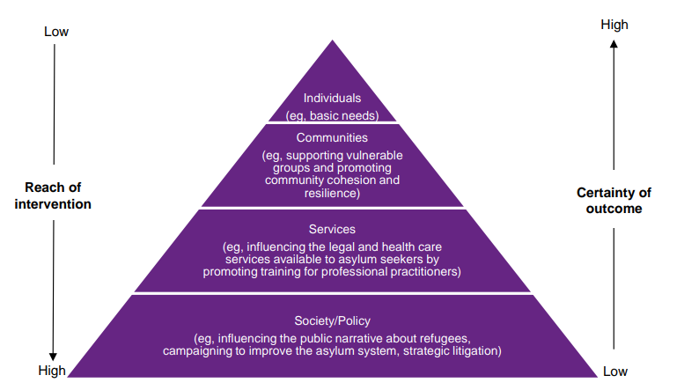
Your Knowledge and Expertise - Funder considerations Effective support doesn't really change
Solutions-for-sanctuary_Overview-of-refugee-and-asylum-seeker-sector_June-20161.pdfe
NPC’s funding levels model

Slide 126
A quick exercise

Slide 127
A quick 'off the top of your head' exercise
You're seeking funding to continue working in an asylum hotel for the next 12 months, but know that the government have pledged to close hotels.
What do you need to consider in your pitch?
How can you evidence these things?

Slide 128
How can we support those who are affected by NRPF and destitution?

Slide 129

What are Public Funds?
Where does ‘No Recourse to Public Funds come from’?
What aren’t Public Funds?

Slide 130

What issues and challenges have you come across in your organisations?

Slide 131

What relevant legislation might you be able to use to support people who would otherwise be destitute?

Slide 132

How to make a formal referral - or – how to get past the ‘gatekeepers’

Slide 133

Resources available
NRPF Network
Project 17

Slide 134
How do we navigate the grey area between labour exploitation and modern slavery?

Slide 135


How do we navigate the grey area between labour exploitation and modern slavery?

Slide 136
Modern Slavery? Labour exploitation? Poor practice?
NEW DEFINITIONS
Labour exploitation – should be used exclusively to refer to criminality under the MSA.
Criminal labour abuse – any other deliberate illegal workplace practice where the worker is the primary aggrieved or endangered party. Examples include charging of illegal work – finding fees, deliberate underpayment of NMW.
Labour market noncompliance – may refer to any illegal practices affecting workers. However, offences are usually noncriminal and moreso breaches of regulatory requirements or contracts.
*please refer to NCA handout for more information on correct terminology.
ACT
Recruitment
Harbouring
MEANS
Deception/Coercion
Threats of deportation
Abuse of power/authority
PURPOSE
Forced or compulsory labour
Financial exploitation
Notes:
Cases vary but many often sit on the periphery between poor work conditions and labour exploitation - not always clear cut Modern Slavery.

Slide 137
Discussion 1 – What do we think of these new definitions? Are they helpful for us to understand the grey area?
Notes:
Cases vary but many often sit on the periphery between poor work conditions and labour exploitation - not always clear cut Modern Slavery.

Slide 138
Common Indicators of LE
International workers particularly impacted in the care sector are of Asian and African nationality
Within construction/agriculture/factory work – tends to be more Eastern Europeans
Skilled workers are charged between £7000 - £50,000 for ‘sponsorship’
Deceived around the job role, responsibilities are not as said
Forced to work excessive hours, working double shifts OR they might be given hardly any hours - sometimes a form of punishment
Forced into tenancy agreements, with ridiculous rent costs and poor conditions
Lack of training/equipment
Coerced into complete duties outside of their role
Non compliance = deportation
Not being paid correctly, unexplained deductions on payslip
Car loans and high charges
Psychological abuse
Encouraged to distrust authorities - led to believe that they will favour the sponsor, being told what to say when authorities arrive
Forced into signing paperwork they do not understand, agreeing to false disciplinary matters
Physical abuse
Threats to them and family members
Substance misuse

Slide 139
Problems causing exploitation in the care sector
Poor staff treatment already exists within the care sector
Long hours, not paid for travel time/mileage, last minute rota’s, pressure to cover shifts
165,000 vacancies in the care sector
Introduction of care workers through the skilled workers visa route
The care sector isn’t regulated by an agency focusing on worker welfare - labour exploitation is therefore hidden
Lack of Education
Lack of understanding of workers rights
Cultural differences in delivering care - international workers not understanding our care system
Lack of due diligence amongst sponsors
International workers are trapped within sponsorship
Sponsorship scheme - difficult to change employer/sponsor
Hesitation for victims to come forward and work with law enforcement, as this can lead to UKVI revoking the sponsorship license which leads to all migrant workers being out of work
When sponsorship is lost, workers have 60 days to find new sponsorship to stay in the UK
No recourse to public funds, so displaced workers are then reliant on illegitimate work, foodbanks, charities and faith centres to survive.
Opportunity for exploiters
Exploiters undercutting the market (recuperating costs from charging international workers), so good employers are losing out
Deceiving overseas job adverts - a quick coin to be made?
Recruiters issuing fraudulent qualifications to workers

Slide 140
Discussion 2 – How could we respond to exploitation in labour practices?
Notes:
Cases vary but many often sit on the periphery between poor work conditions and labour exploitation - not always clear cut Modern Slavery.

Slide 141

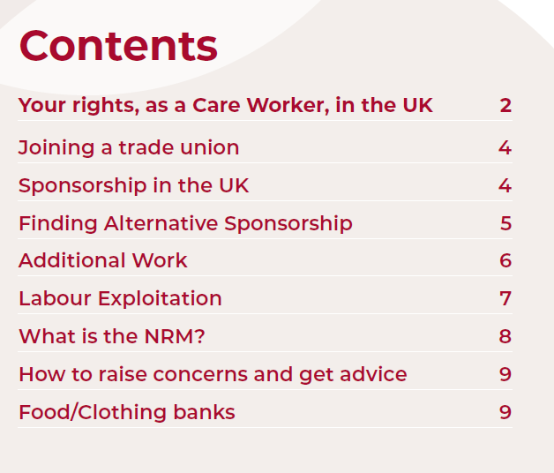
Supporting victims/displaced workers
Lots of ongoing discussions between GLAA, UKVI, DHSC and Government to fix the wider issues. But in the meantime:
If MSHT/Labour exploitation - NRM and investigate
If not, handout Justice & Care leaflet
If poor working practices (labour market non-compliance), advise worker to join a union
If not receiving enough hours, remind them of the additional 20 hours
If complaint is about fees paid, they could pursue a civil claim if transaction happened in the UK
Cost of living - signpost to local food/clothing banks, faith centres
Children as dependants - notify LA Social Services for family support
Poor housing provided by sponsor – encourage them to move out
Finding a new sponsor - Gov website for list. Borderless - https://www.getborderless.co.uk/job-seekers Lifted Care - https://www.sponsorswitch.com/
If license has been revoked worker should get an email from UKVI directing them to international recruitment support.

Slide 142
Discussion 3 – Are there any other ways in which we can support victims/workers who fall into the grey area of support?
Notes:
Cases vary but many often sit on the periphery between poor work conditions and labour exploitation - not always clear cut Modern Slavery.

Slide 143
Jess Clayton - GLAA Victim Navigator
jess@justiceandcare.org

Slide 144
Pulling together and moving forward - from vision to action

Slide 145
Group discussion
What ideas have you had throughout the day?
What is the one thing you'd like to focus on first?

Slide 146
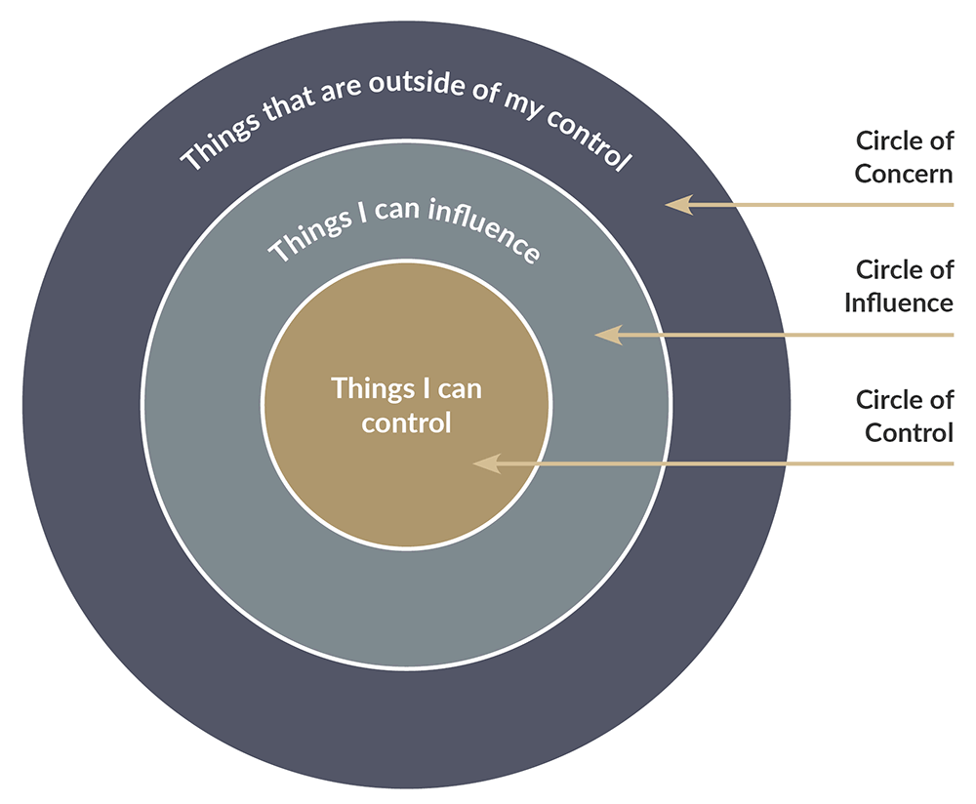
What's stopping you?
What are the barriers?
What can you control?
What can you influence?
What can't you control?

Slide 147
How do we influence change?
Who do you want to influence and to do what?
What tools and resources do you need?
Who can provide these?

Slide 148
What can you control?
What key issue(s) would you like to focus on?
What tools and resources do you need?
Who can provide these?

Slide 149
What happens next?
Your own personal and organisational action plans
'Quick wins' – immediate sector wide actions
Migration Yorkshire VCS Strategy
Anything else?

